Slide 1
LIFE/work balance
We have started a #LIFEworkbalance campaign and we need your help to complete our LIFE/work balance survey.
We hope to publish the results soon, so please give 15 minutes of your time to help us get a true picture of school life.
Want to be a part of this campaign? Take the survey on our website and share it with your colleagues!
© Classroom Secrets Limited 2019

Slide 2
Year 1 – Autumn Block 2 – Addition and Subtraction – Number Bonds within 10
About This Resource:
This PowerPoint has been designed to support your teaching of this small step. It includes a starter activity and an example of each question from the Varied Fluency and Reasoning and Problem Solving resources also provided in this pack. You can choose to work through all examples provided or a selection of them depending on the needs of your class.
National Curriculum Objectives:
Mathematics Year 1: (1C1) Represent and use number bonds and related subtraction facts within 20
Mathematics Year 1: (1C4) Solve one-step problems that involve addition and subtraction, using concrete objects and pictorial representations, and missing number problems such as 7 = – 9
More Year 1 Addition and Subtraction resources.
Did you like this resource? Don’t forget to review it on our website.
© Classroom Secrets Limited 2018

Slide 3
Year 1 – Autumn Block 2 – Addition and Subtraction
Step 4: Number Bonds within 10
© Classroom Secrets Limited 2018

Slide 4
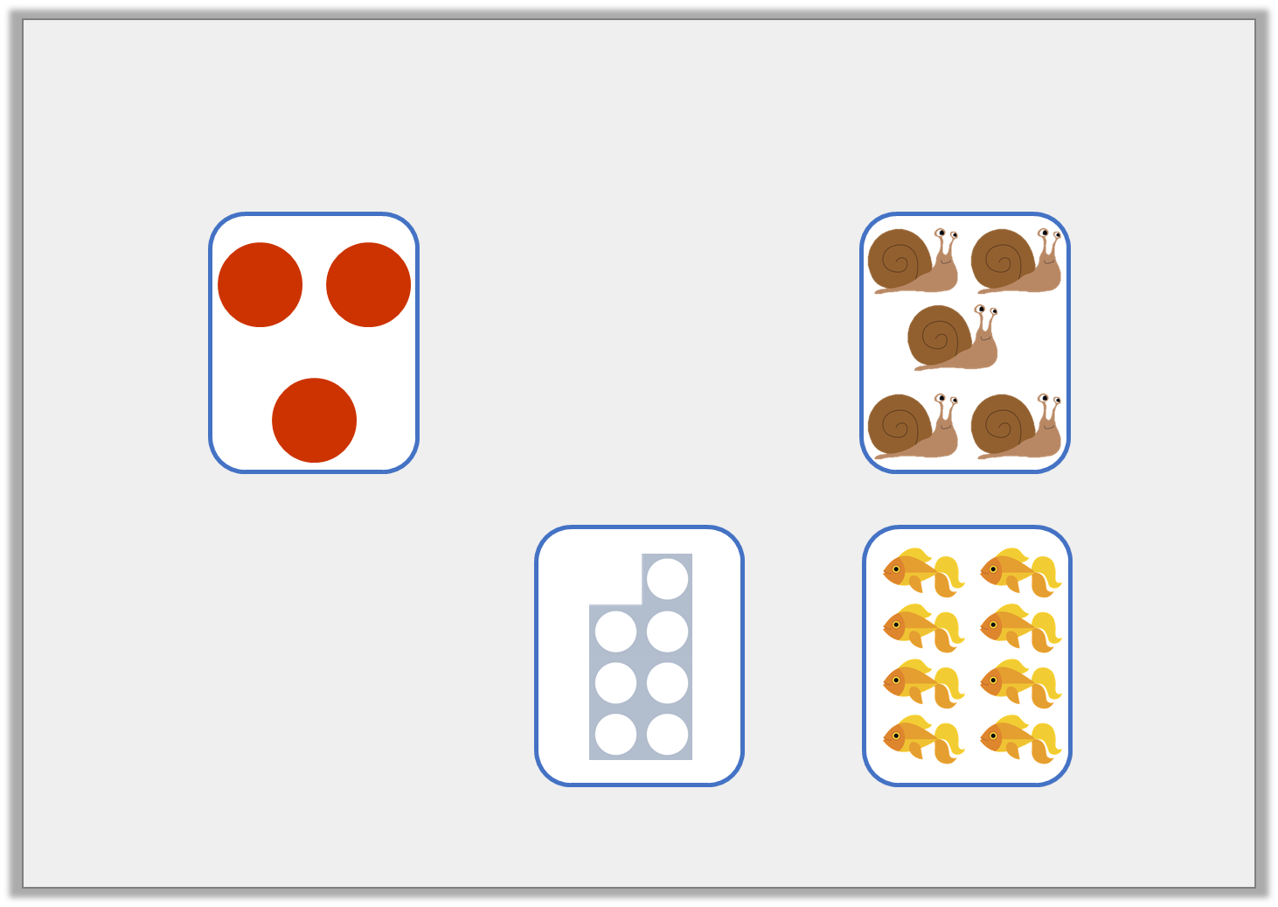
Introduction
Find the numbers which can join to make a fact family.
2
9
© Classroom Secrets Limited 2018

Slide 5
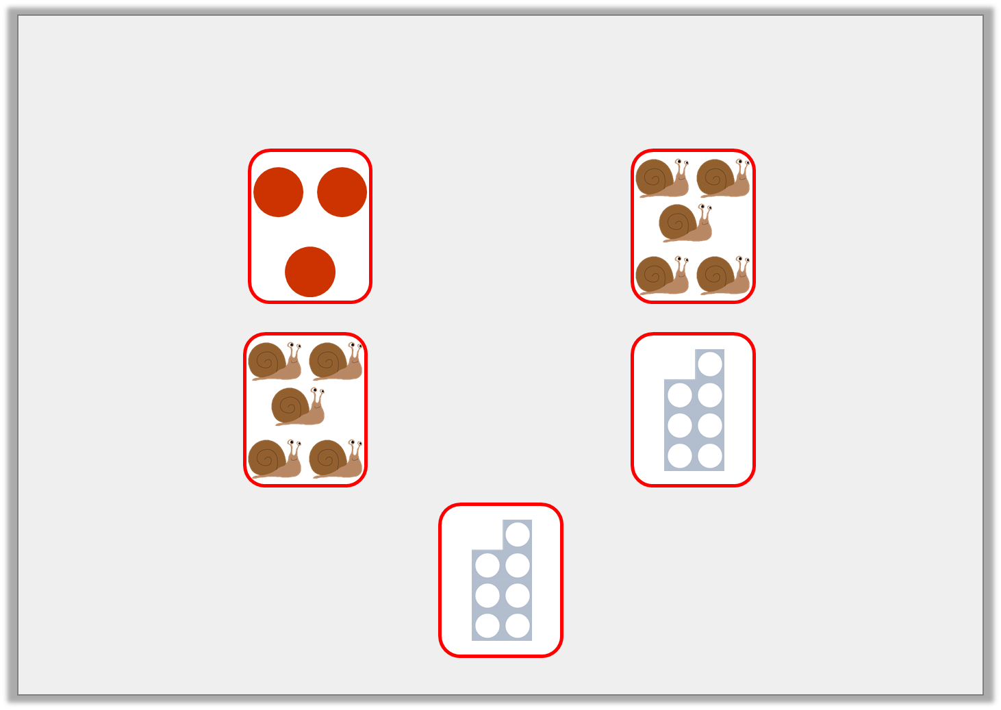
Introduction
Find the numbers which can join to make a fact family.
2
2
2
9
© Classroom Secrets Limited 2018

Slide 6
Varied Fluency 1
Find four number bonds to 9.
Use the part whole model to record your answers.
9
© Classroom Secrets Limited 2018

Slide 7
Varied Fluency 1
Find four number bonds to 9.
Use the part whole model to record your answers.
Various answers, for example: 0 and 9; 1 and 8; 2 and 7; 3 and 6; 4 and 5.
9
3
6
© Classroom Secrets Limited 2018

Slide 8
Varied Fluency 2
Write two number sentences to represent the number bond shown in the ten frame.
© Classroom Secrets Limited 2018

Slide 9
Varied Fluency 2
Write two number sentences to represent the number bond shown in the ten frame.
2 + 5 = 7 and 5 + 2 = 7
© Classroom Secrets Limited 2018

Slide 10
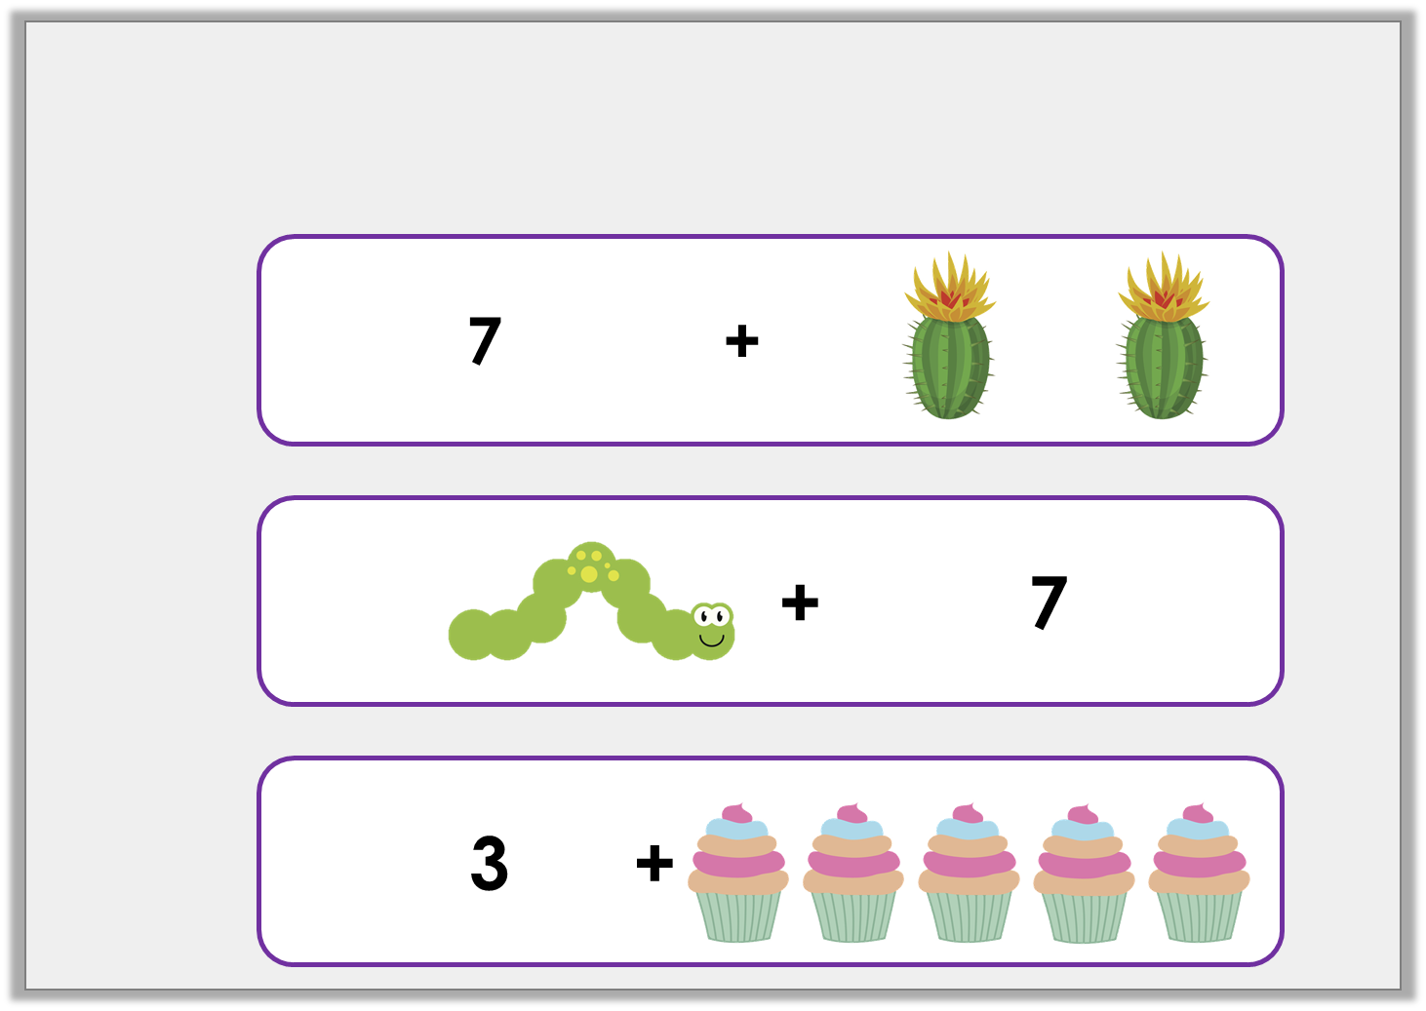
Varied Fluency 3
Danny says all his cards show number bonds to 9. Is he correct?
A.
B.
C.
© Classroom Secrets Limited 2018

Slide 11
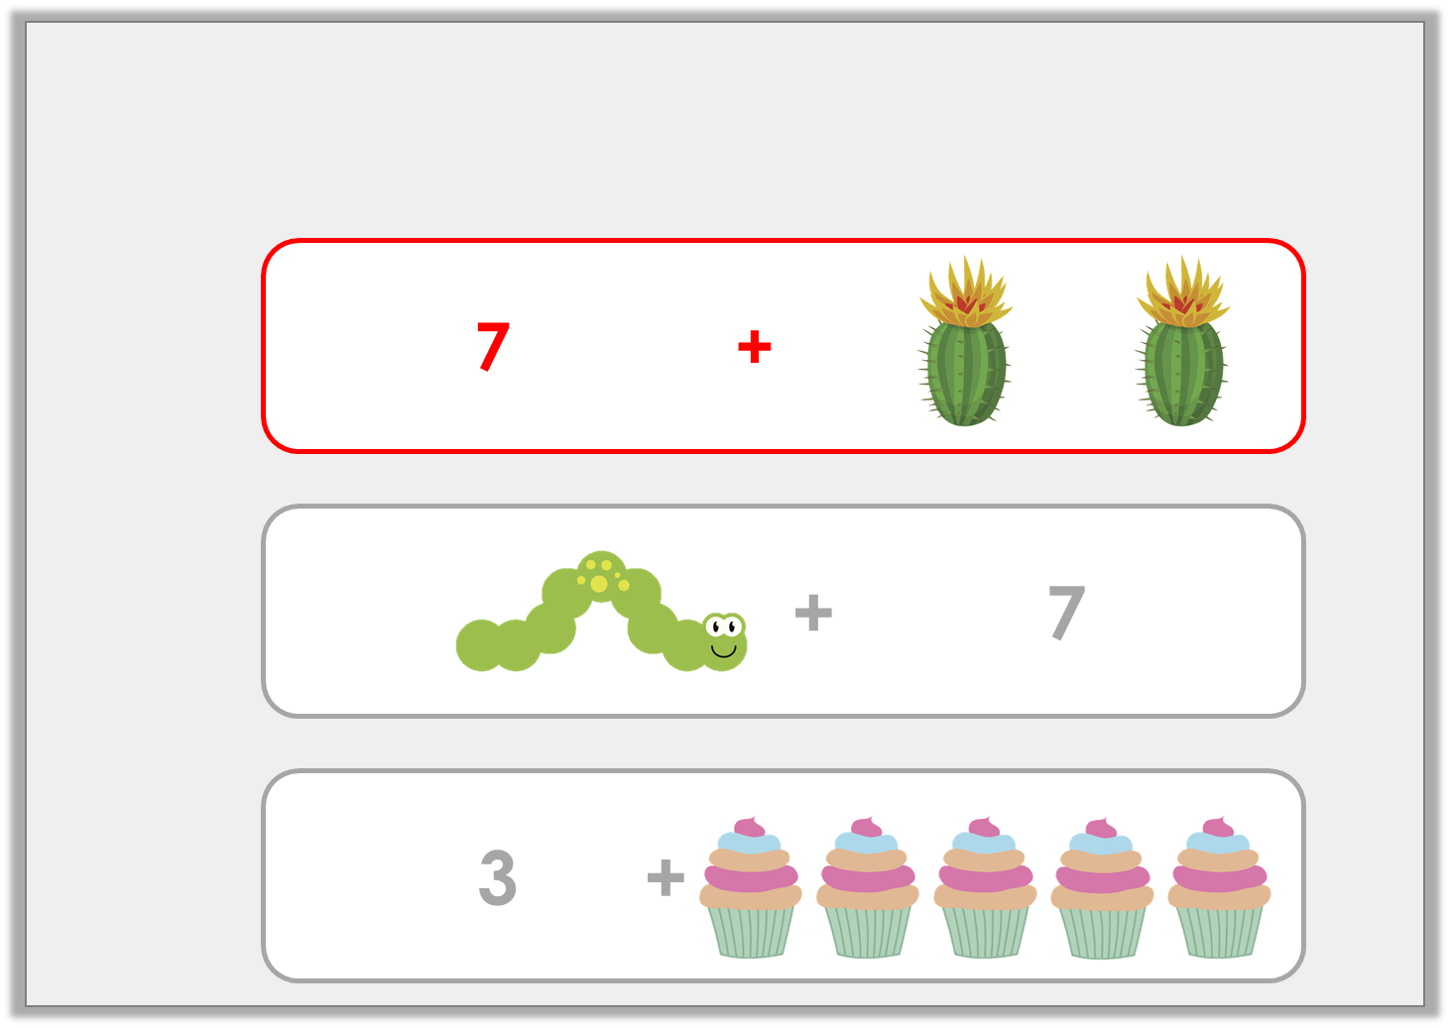
Varied Fluency 3
Danny says all his cards show number bonds to 9. Is he correct?
No
A.
B.
C.
© Classroom Secrets Limited 2018

Slide 12
Reasoning 1
Jane is making number bonds to 9.
Which is the odd one out? Explain why.
A. | B.
C. | D.
8 | + | 1 | = | 9
2
8
© Classroom Secrets Limited 2018

Slide 13
Reasoning 1
Jane is making number bonds to 9.
Which is the odd one out? Explain why.
C, because...
A. | B.
C. | D.
8 | + | 1 | = | 9
2
8
© Classroom Secrets Limited 2018

Slide 14
Reasoning 1
Jane is making number bonds to 9.
Which is the odd one out? Explain why.
C, because 8 + 2 = 10
A. | B.
C. | D.
8 | + | 1 | = | 9
2
8
© Classroom Secrets Limited 2018

Slide 15
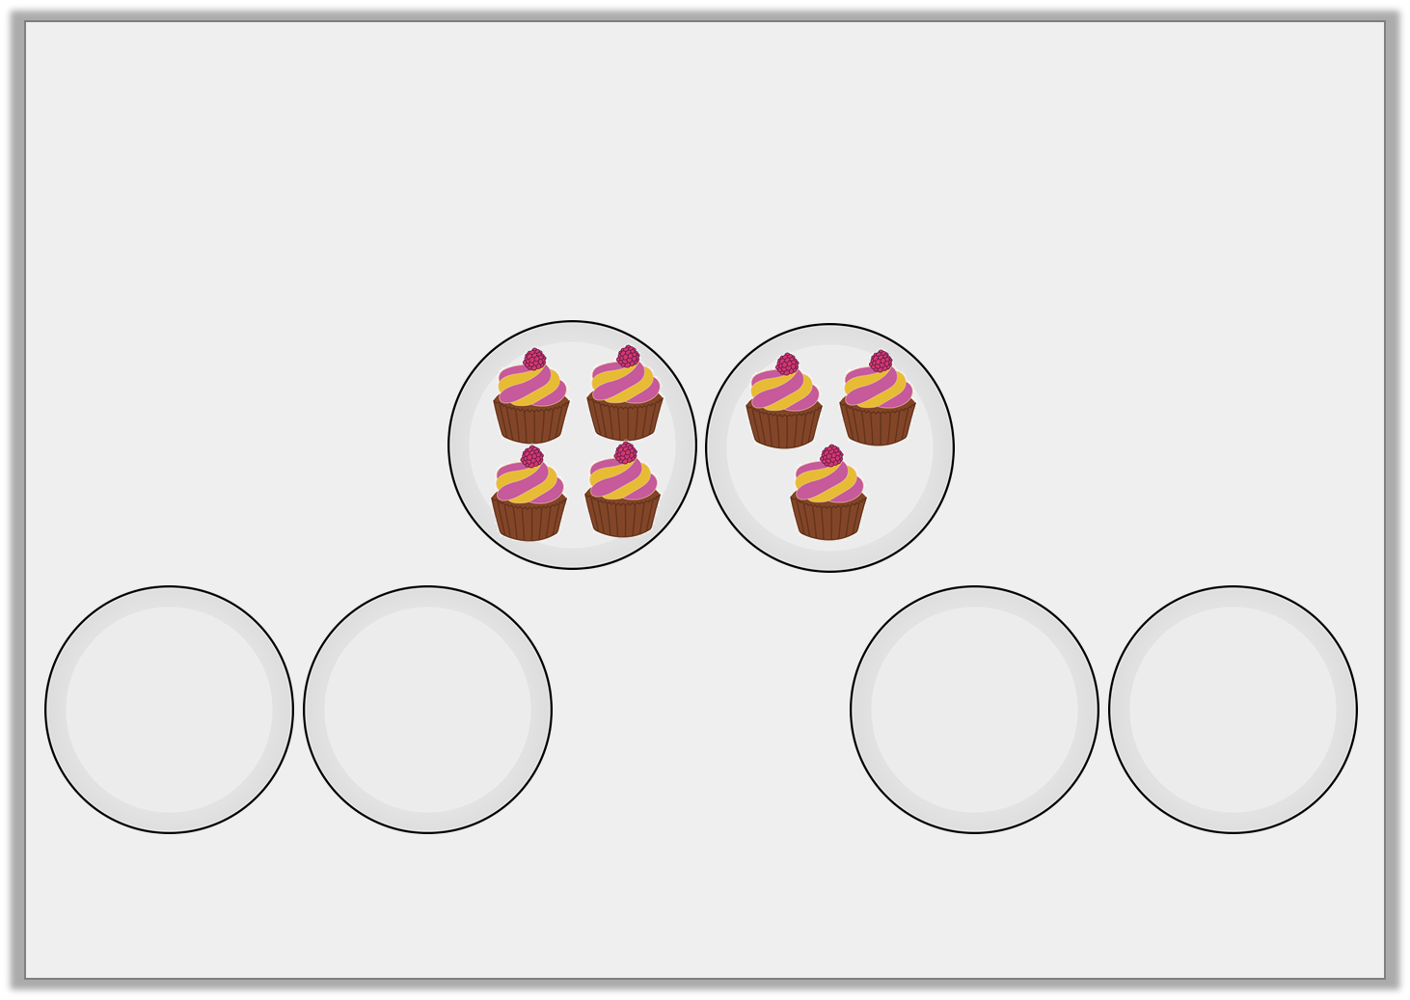
Problem Solving 1
Each box has 7 buns in total shared on two plates.
None of the plates look the same.
Draw the buns on the plates.
BUNS
BUNS
BUNS
© Classroom Secrets Limited 2018

Slide 16
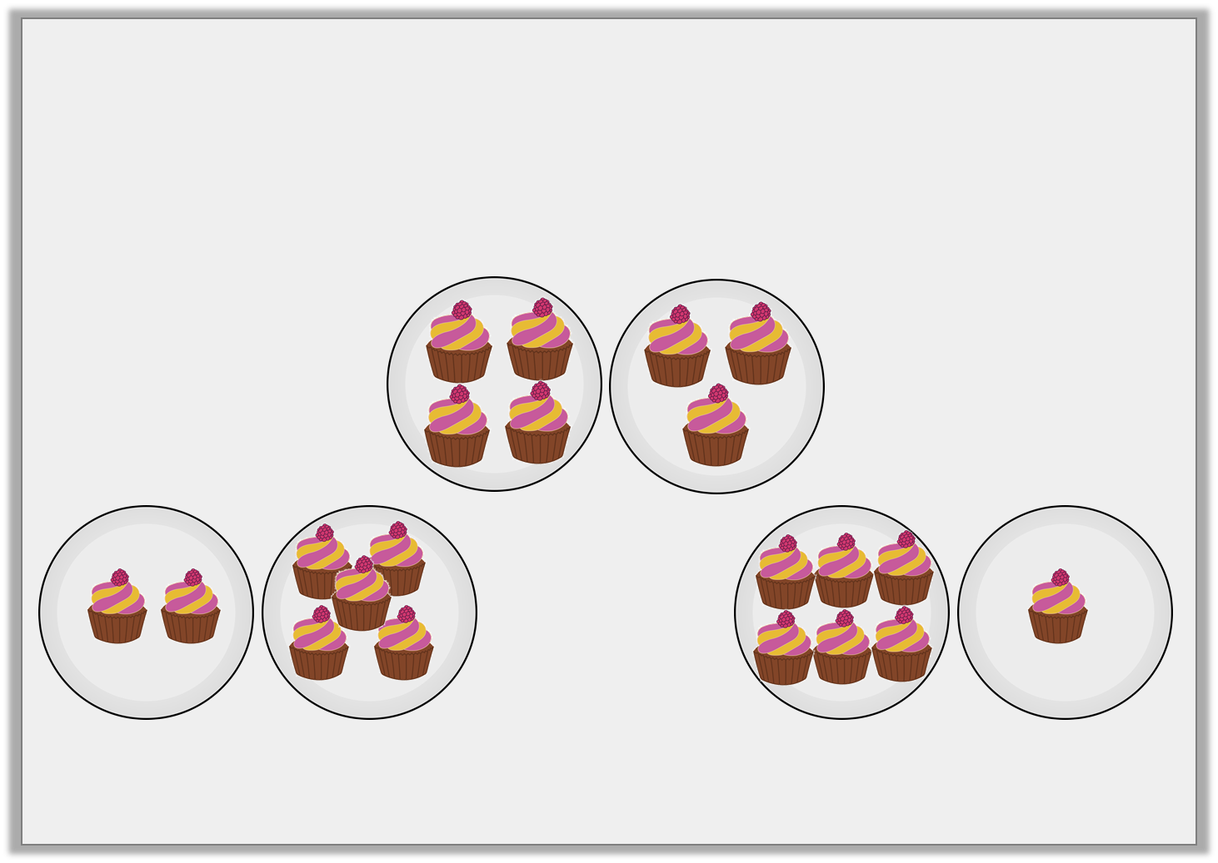
Problem Solving 1
Each box has 7 buns in total shared on two plates.
None of the plates look the same.
Draw the buns on the plates.
Various answers, for example: 7 and 0; 6 and 1; 5 and 2.
BUNS
BUNS
BUNS
© Classroom Secrets Limited 2018

Slide 17
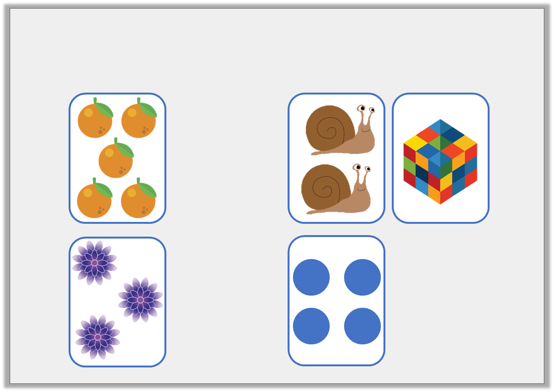
Problem Solving 2
Which pairs of cards make number bonds to 6?
6
0
3
© Classroom Secrets Limited 2018

Slide 18
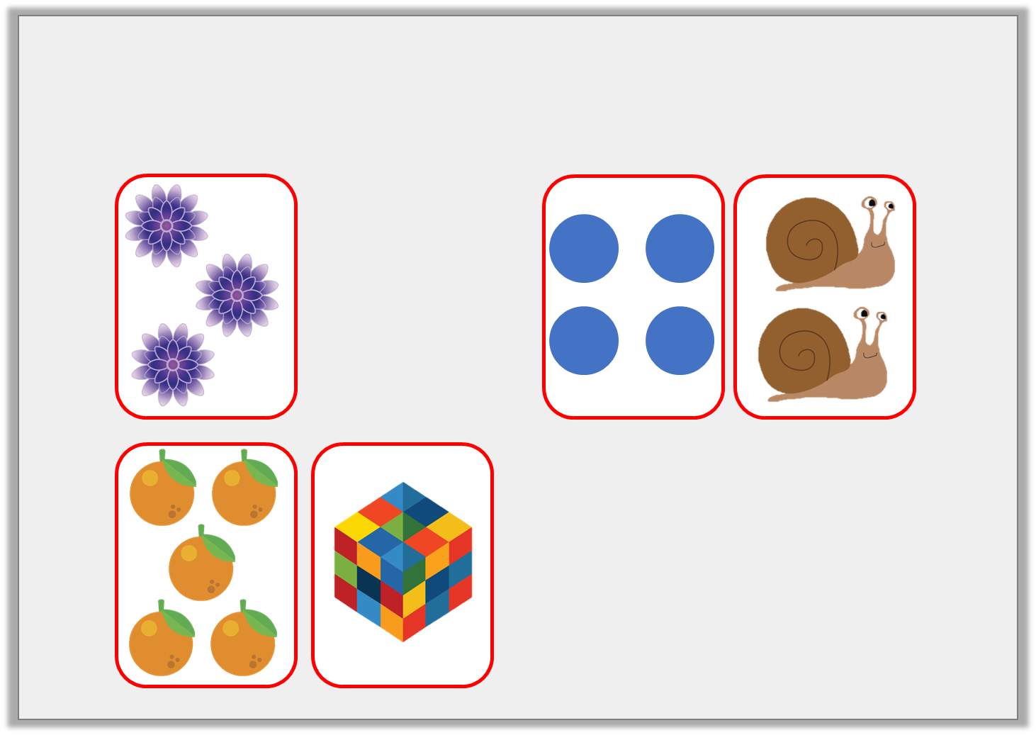
Problem Solving 2
Which pairs of cards make number bonds to 6?
3
6
0
© Classroom Secrets Limited 2018

